Slide 1

Amounts awarded under Article 149 of the French Code of Criminal Procedure in relation to wrongful detention.
Lina Benahmed
Maxime Célérier-Davril
Pierre-Marie Fusz
Anaëlle Trébulle

Slide 2
Summary
Presentation of Article 149 of the French Criminal Procedure Code
Presentation of the algorithm
Presentation of the dataframe
Results & Analysis
Aim of the algorithm
Difficulties & Improvement

Slide 3
Article 149 French Criminal Procedure Code
A person who has been remanded in custody during proceedings which have ended with a final decision to dismiss the case, shall be entitled, at his or her request, to full compensation for the non-material and material damage caused by that detention.

Slide 4
Question
Our presentation aims to investigate whether compensations are being paid and, if so, what the average amounts are

Slide 5
Aim of the algorithm
/
Obtain legal certainty on the quantification of compensation amounts due to wrongful detention.
Gain better understanding of the possible compensation amounts awarded under Article 149 of the French Code de procédure pénale.

Slide 6
Method of the algorithm
Conduct
Conduct a statistical analysis of
case law related to compensation for wrongful detention.
Collect and analyze
Collect and analyze data
from judicial authorities.
Focus
Focus on cases related to the relevant legal provisions.

Slide 7
Summary of Actions
Collect data using
Légifrance in order to find judgments.
Find a list of all relevant judgment
URLs and collect
metadata such as the type of court of appeal and date.
Use a loop to scrape each judgment individually and use regex to find the desired data, including the outcome and allocated amounts.
Place this data into sub-lists and join them t
o create a common
list to generate a dataframe using the
list of lists method to obtain a .csv file.
Synthesize and clean the data as necessary (e.g.
transforming amounts into numbers) and convert dates to datetime format to make them
suitable for use as the dataframe's index for analyzing
durations.
From the cleaned/
synthesized data,
obtain graphs and measurements to answer the question.

Slide 8
Collect data using Légifrance in order to find judgments
Go
Go to the Légifrance website.
Launch
Launch a search for all judgments rendered under the provision of Article 149 of the Code of Criminal Procedure.
Extract
Extract the URLs of the judgments found during the search.
Confirm
Confirm that 373 judgments were extracted.
Use
Use the extracted URLs to perform further actions as needed, such as scraping the judgments individually and extracting relevant data using regex.

Slide 9
Scraping process

Slide 10
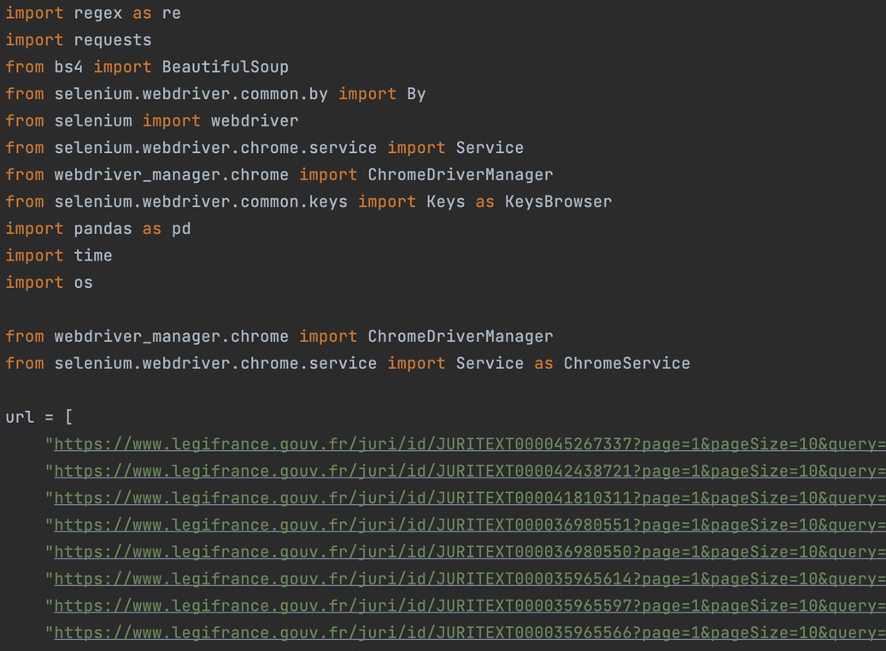
Scraping process

Slide 11
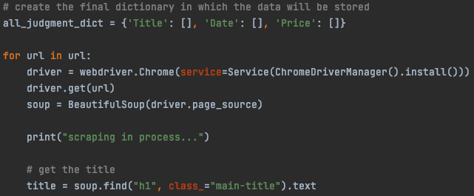
Scraping Process
1 : Create the final dictionary and start the scraping process by getting the title

Slide 12
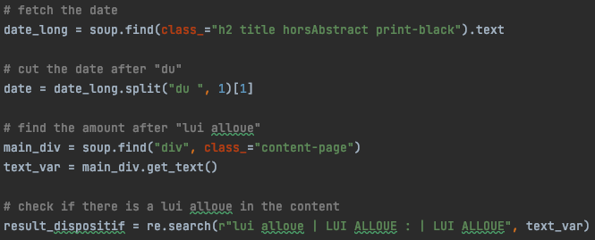
Scraping Process
2 : Fetch the date and cut after "du". Also, indicate that the amount is located in the "dispositif" (operative part of the ruling) after "Lui Alloue" and all synonyms of this sentence

Slide 13
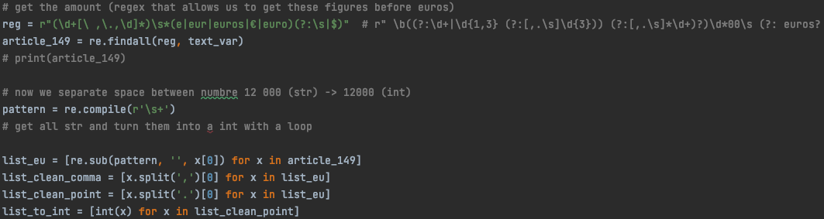
Scraping Process
3. Extract the amount using regex, and indicate all signs that could be used for "euros"

Slide 14
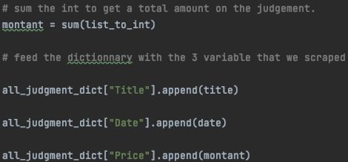
Scraping Process
4. Filing of the data collected before it is cleaned and analysed

Slide 15
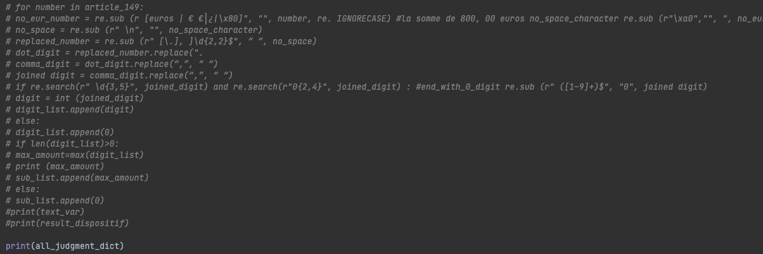
Scraping Process
5. Confirm the extraction of all collected data

Slide 16
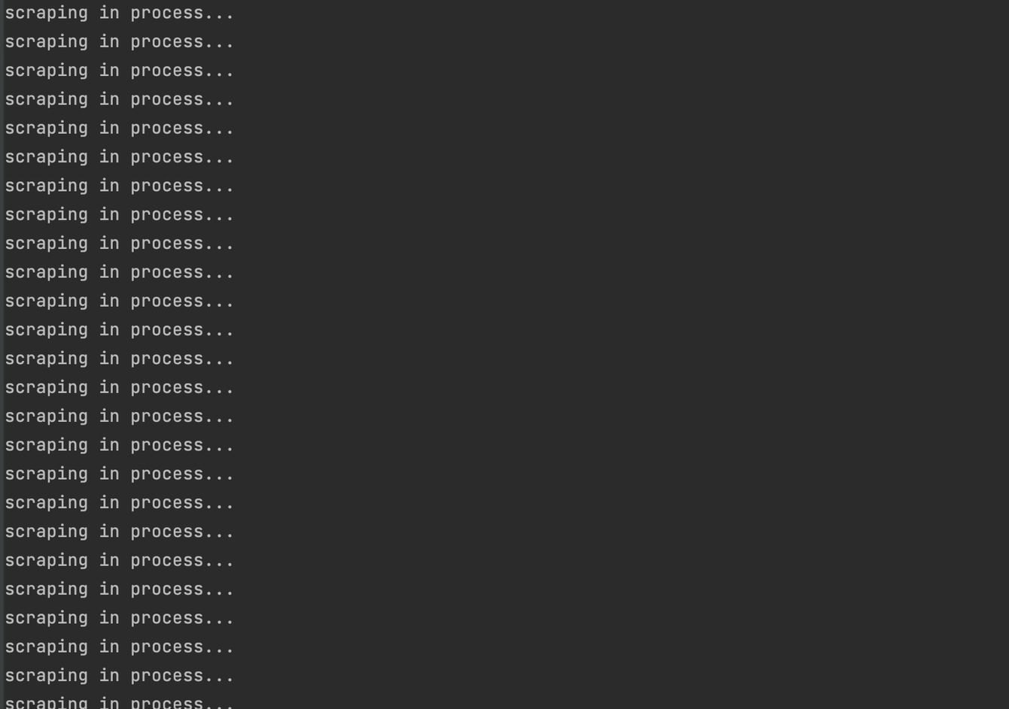
Scraping in Process

Slide 17
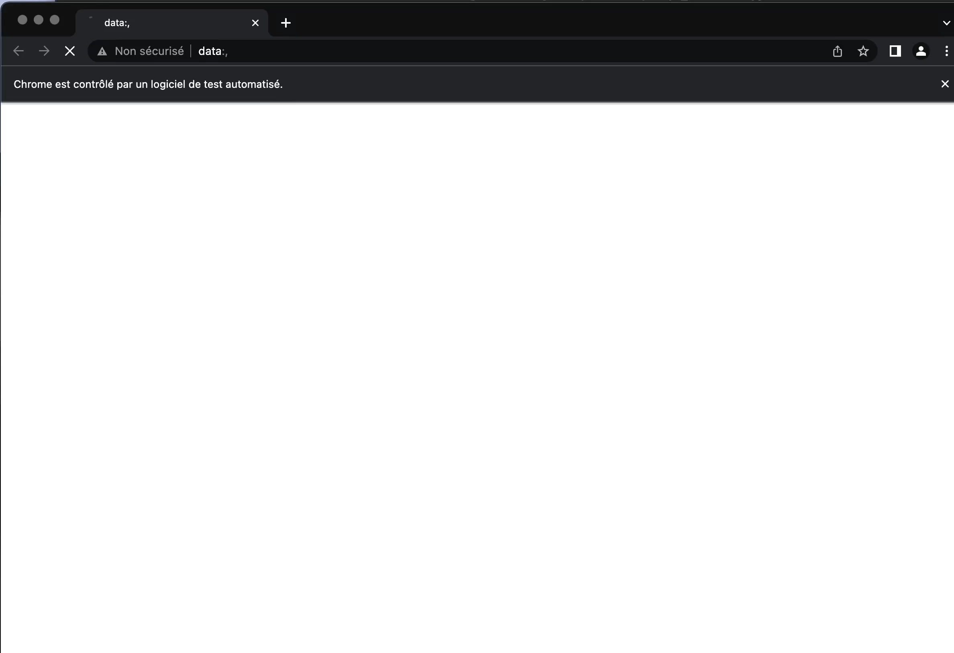
Scraping

Slide 18
Dataframe

Slide 19
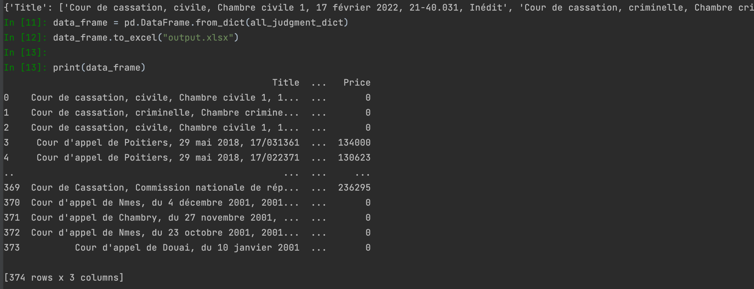
Build a dataframe

Slide 20
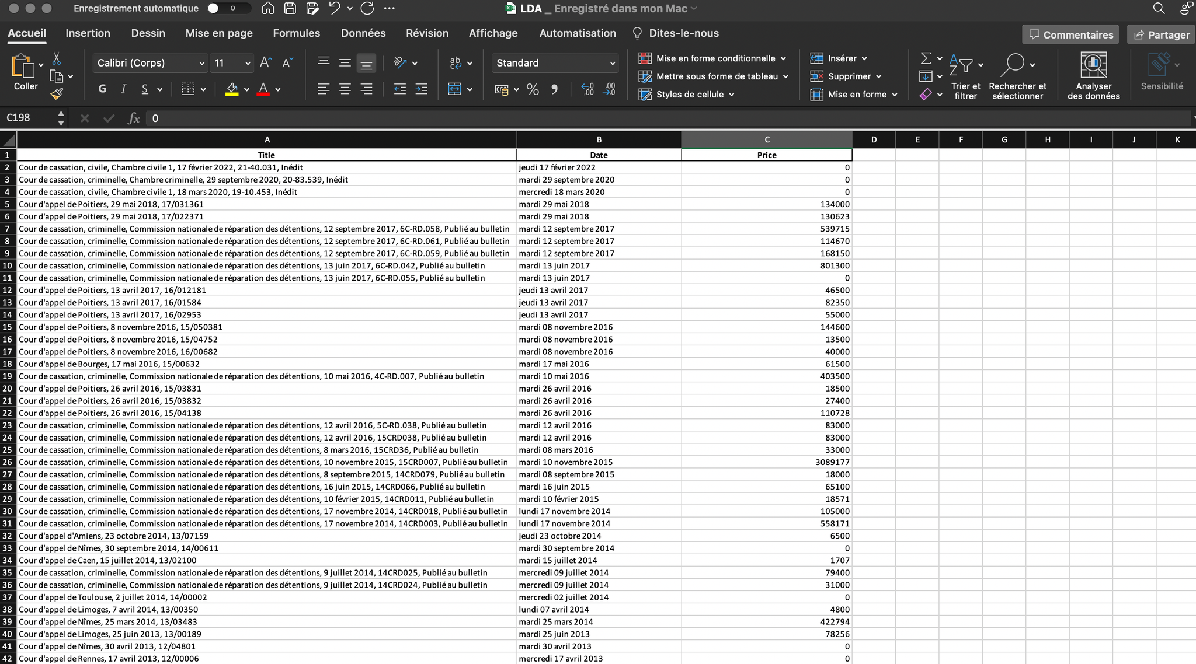
Export the dataframe

Slide 21
General information on extracted decisions
205 decisions granted more than 0 euros
171 decisions refused to grant an amount pursuant to Article 149

Slide 22
Results & Interpretation

Slide 23

Global average of Article 149 (when attributed) over 22 years
245 008 euros

Slide 24
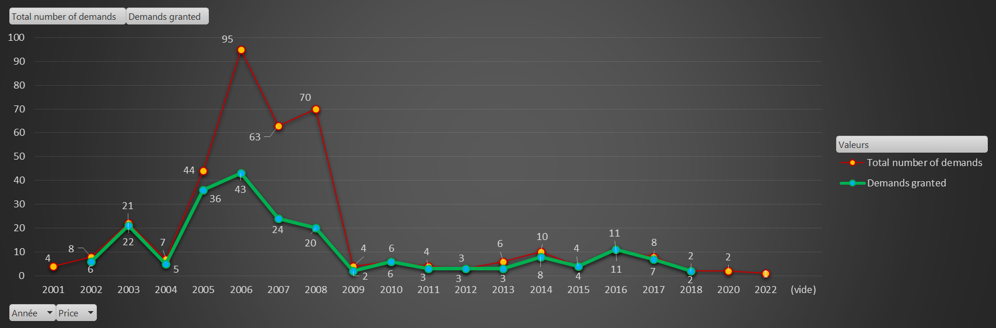
Number of Article 149 demanded and granted per year
Inclure ici l'image du Graphique par année

Slide 25
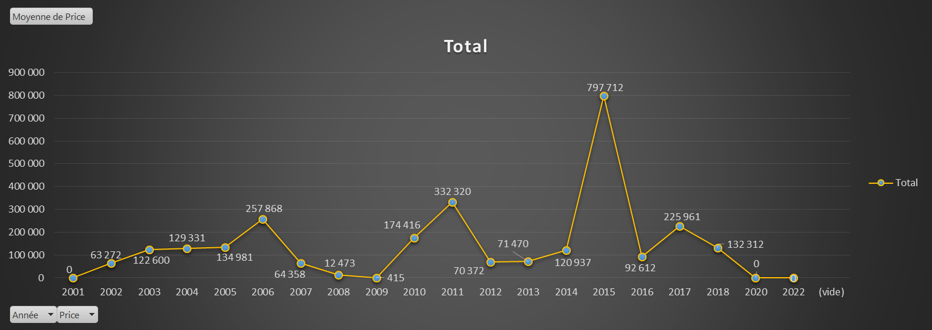
Average value of Article 149, when granted, per year

Slide 26
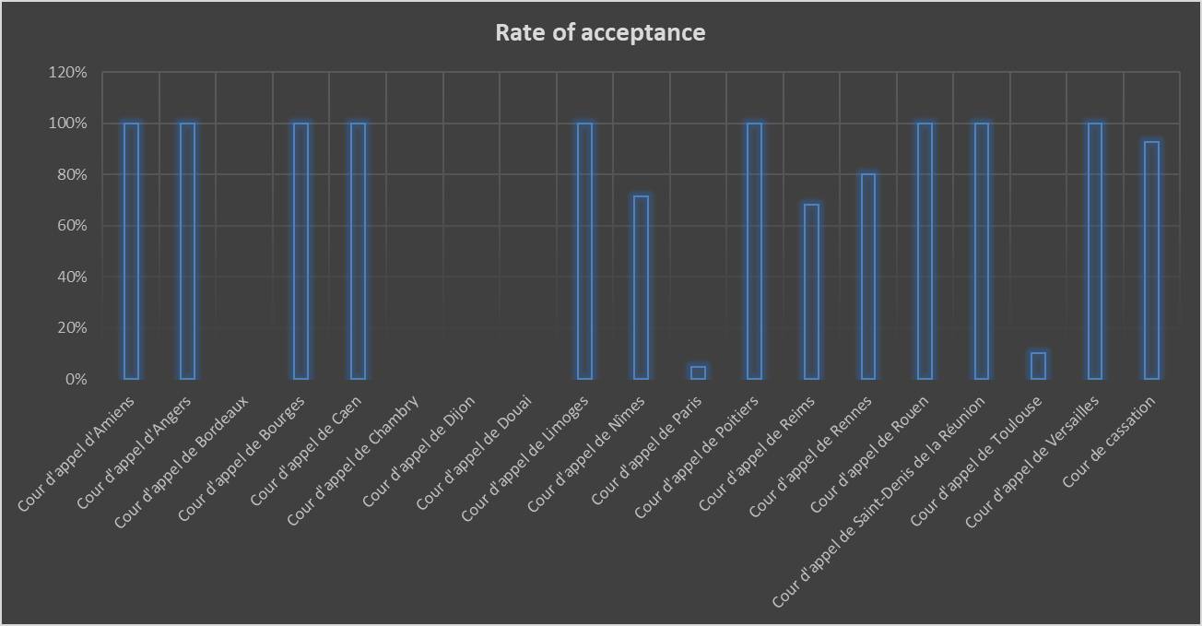
Rate of acceptance depending on the court

Slide 27
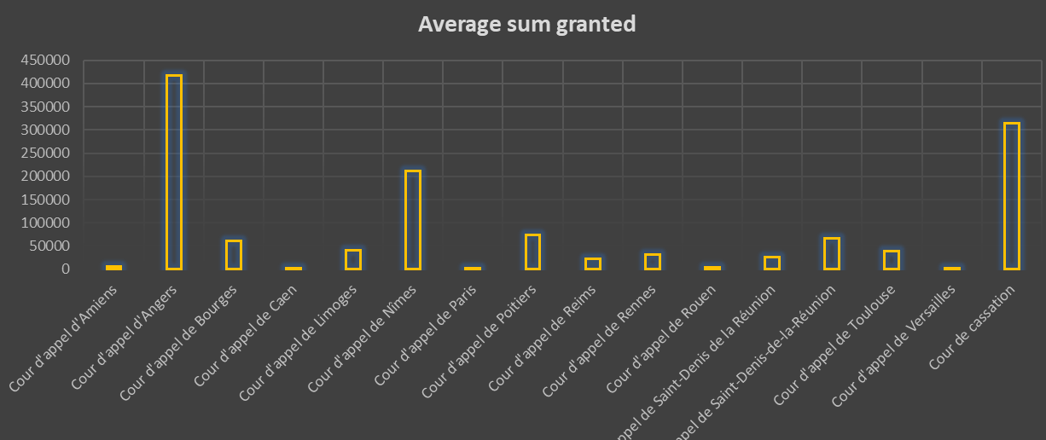
Average sum granted depending on the court

Slide 28
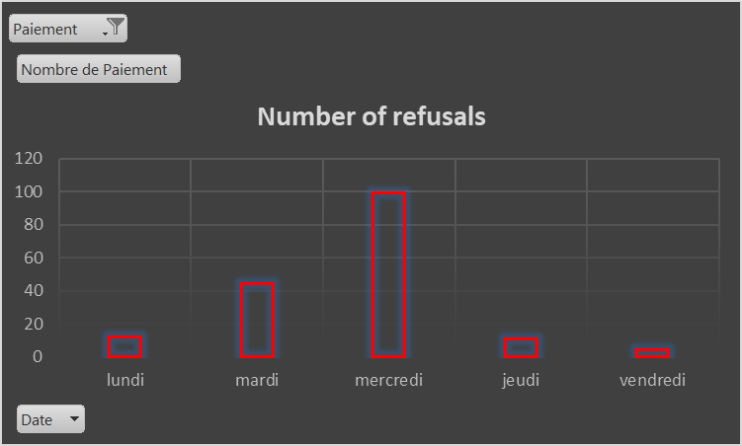
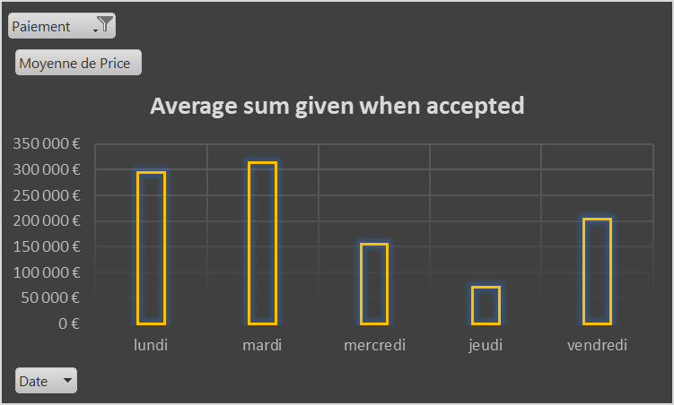
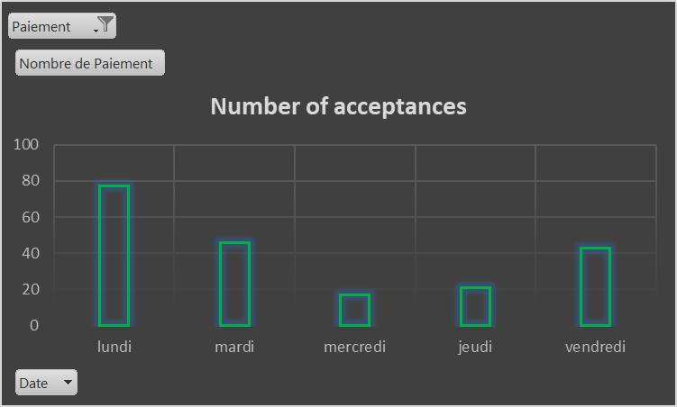
Statistics depending on the day of the week

Slide 29
Difficulties & Improvement
Lack of uniformity in court decisions
Considering a larger number of rulings
Associating granted amounts with specific requests
Extending the analysis to other legal fields
Our study covered all courts, including the Court of Cassation, although this court only judges in law.
We could have limited the scope to the courts of appeal or even the most important courts of appeal in France.
Utilizing the normal distribution to estimate the 95% range of awarded amounts (within +/- 2 standard deviations from the mean)

Slide 30
Thank you!

